Slide 1
Emotions

Slide 2
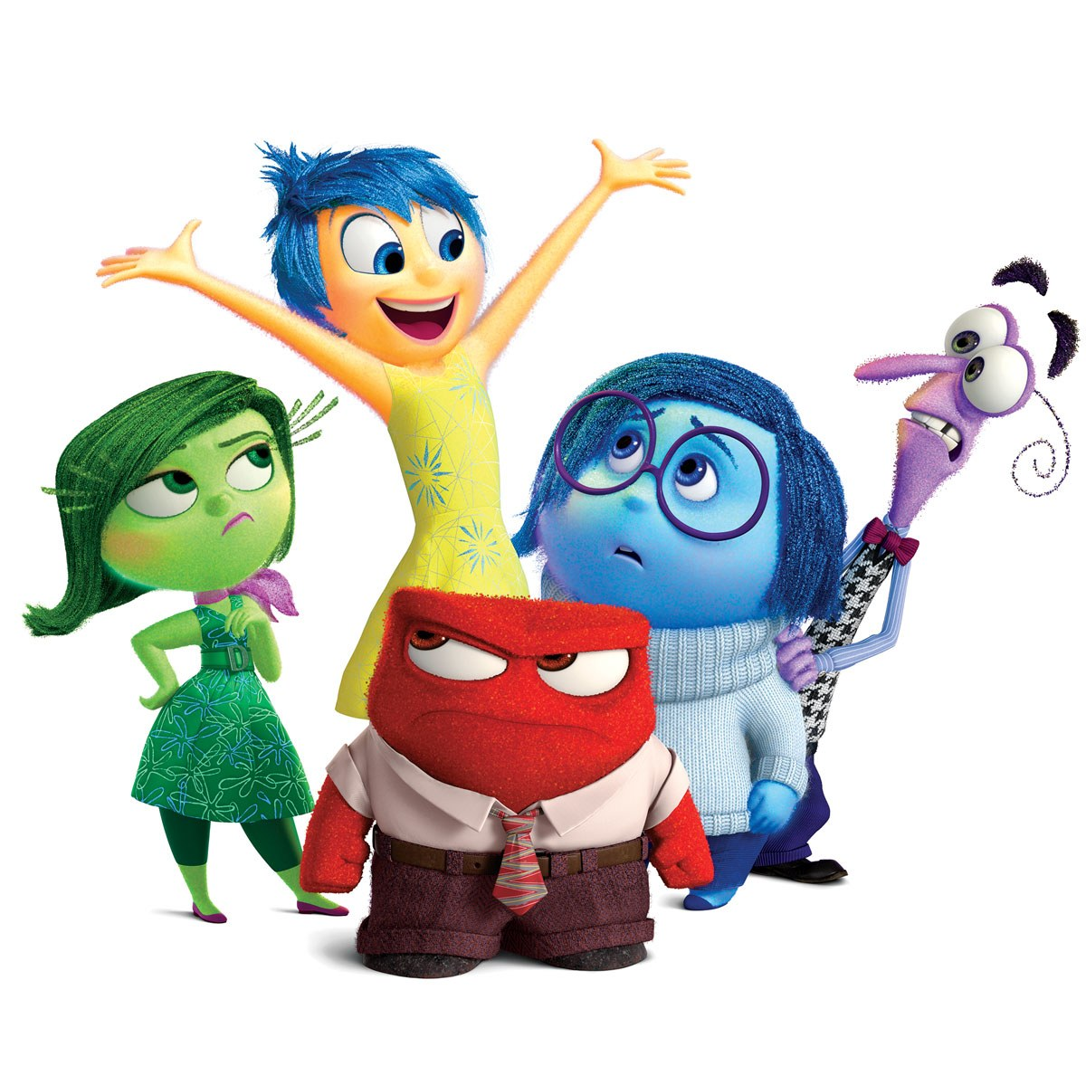
Video: Get to know your emotions

Slide 3
E M O T I O N S
What are some examples of emotions?

Slide 4
What is an emotion?
An emotion is the way you are feeling.
How are you feeling?

Slide 5
How can you tell what emotion you are having?
How your body feels
How you are breathing
How fast your heart is beating
How tight your muscles feel
How you are moving
What you are thinking

Slide 6
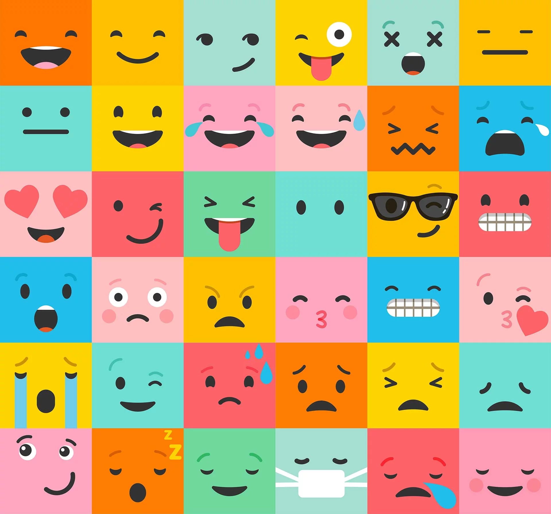
How many different emotions can you identify?

Slide 7
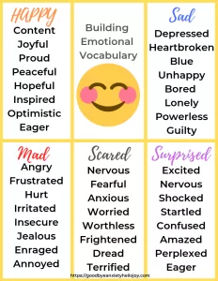

Slide 8
Emotions are...
Normal. We all have them.
Temporary. They come and go.
Something we can learn to notice.
Something we can learn to regulate*.
(*Regulate means to control so we can function properly)

Slide 9
This Week
NOTICE YOUR EMOTIONS

Slide 10
Next Week’s
Question:
What have you noticed about your emotions?

